Slide 1
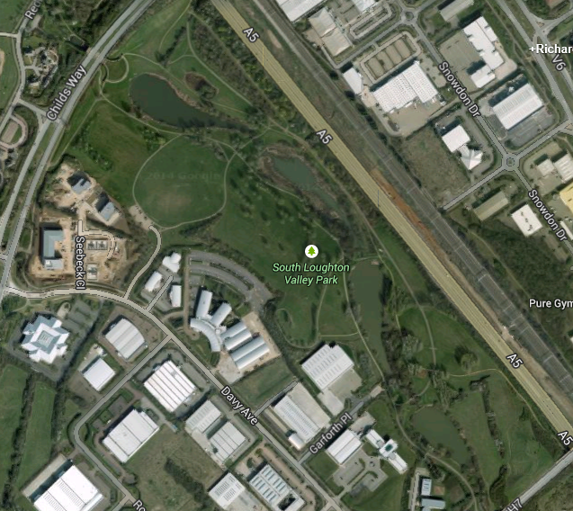
U17/U20 Women
13:00
1 Small Lap + 1 Large Lap
A-B-C-A-B-C-D-E-D-F-C-Finish
F
C
Turn for small lap
Start
D
A
Finish
B
E

